Slide 1

Molecular Systematics
Judd et al pp. 13-17
The use of DNA and RNA sequences to infer evolutionary relationships

Slide 2
Why Introduce Molecular Systematics?
So you gain a basic understanding of the tools available, what they can and can’t offer, and how they work
To provide you with the vocabulary and concepts used by molecular systematists
NOT to teach you how to go into a lab and start doing the work
It’s the wave of the present and future

Slide 3
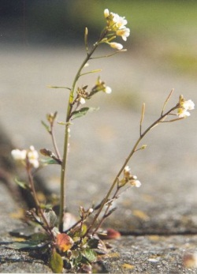
Arabidopsis thaliana: first plant genome to be sequenced.
Sequencing began in 1996 and was completed in 2000. 125 Mbp (=125 million base pairs!)

Slide 4
DNA sequencing techniques are driven by speed and cost
Major landmarks in DNA sequencing
1953 Discovery of the structure of the DNA double helix.^{[49]}
1972 Development of recombinant DNA technology, which permits isolation of defined fragments of DNA; prior to this, the only accessible samples for sequencing were from bacteriophage or virus DNA.
1977 The first complete DNA genome to be sequenced is that of bacteriophage φX174.^{[50]}
1977 Allan Maxam and Walter Gilbert publish "DNA sequencing by chemical degradation".^{[5]} Frederick Sanger, independently, publishes "DNA sequencing with chain-terminating inhibitors".^{[51]}
1984 Medical Research Council scientists decipher the complete DNA sequence of the Epstein-Barr virus, 170 kb.
1986 Leroy E. Hood's laboratory at the California Institute of Technology and Smith announce the first semi-automated DNA sequencing machine.
1987 Applied Biosystems markets first automated sequencing machine, the model ABI 370.
1990 The U.S. National Institutes of Health (NIH) begins large-scale sequencing trials on Mycoplasma capricolum, Escherichia coli, Caenorhabditis elegans, and Saccharomyces cerevisiae (at US$0.75/base).
1991 Sequencing of human expressed sequence tags begins in Craig Venter's lab, an attempt to capture the coding fraction of the human genome.^{[52]}
1995 Craig Venter, Hamilton Smith, and colleagues at The Institute for Genomic Research (TIGR) publish the first complete genome of a free-living organism, the bacterium Haemophilus influenzae. The circular chromosome contains 1,830,137 bases and its publication in the journal Science^{[53]} marks the first use of whole-genome shotgun sequencing, eliminating the need for initial mapping efforts.
1996 Pål Nyrén and his student Mostafa Ronaghi at the Royal Institute of Technology in Stockholm publish their method of pyrosequencing^{[54]}
1998 Phil Green and Brent Ewing of the University of Washington publish “phred” for sequencer data analysis.^{[55]}
2000 Lynx Therapeutics publishes and markets "MPSS" - a parallelized, adapter/ligation-mediated, bead-based sequencing technology, launching "next-generation" sequencing.^{[56]}
2001 A draft sequence of the human genome is published.^{[57][58]}
2004 454 Life Sciences markets a parallelized version of pyrosequencing.^{[59][60]} The first version of their machine reduced sequencing costs 6-fold compared to automated Sanger sequencing, and was the second of a new generation of sequencing technologies, after MPSS.^{[29]}

Slide 5
Molecular Data
Many more molecular characters available for analysis than morphological ones.
Identity is easier to define: ATCG vs. whether a flower color is pink or white.
Nonetheless, molecular data are still subject to homoplasy: reversals and convergence as well as long branch attraction (errors due to mutation rate being fast and number of characters small: leads to wrong phylogenetic tree appearing to be correct.

Slide 6
For example, two plants may have a “C” at a particular location on a gene
One possibility is that they have evolved together and are closely related
Another possibility is that one started at with the “C” at that location and it didn’t change, while the other plant went “C->G->A->T->C” and looks like it’s the same evolution because all you see is the start and finish “C”

Slide 7
Modern Phylogenetics
In spite of the pitfalls, “DNA sequence data are now overwhelmingly the tool of choice for generating phylogenetic hypotheses.” from J&C, pg. 103
Much of this data is on the web.
National Center for Biotechnology Information
http://www.ncbi.nlm.nih.gov/

Slide 8
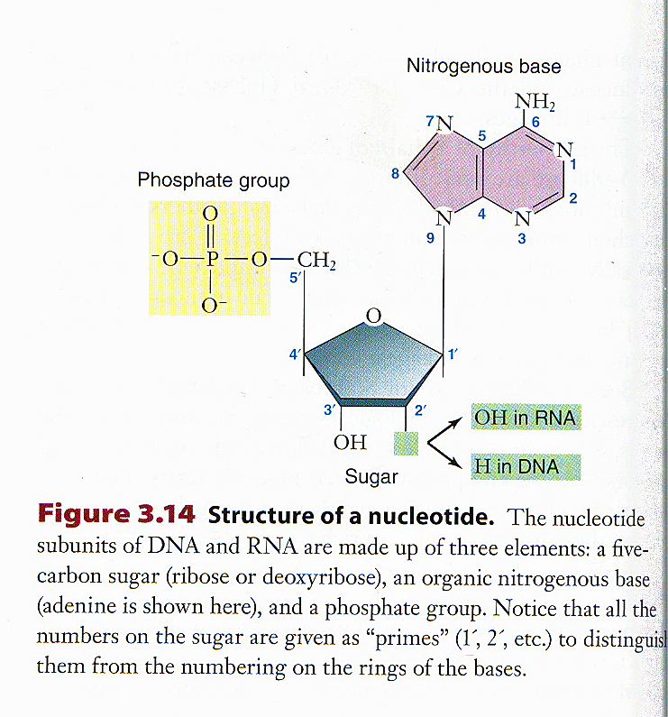
Nucleotide Structure– Phosphate group, sugar and nitrogenous base
Hooks up with the position 3’ OH group on the next nucleotide
**Required to hook nucleotides together in the making of DNA
Hence “deoxy-” in DNA

Slide 9
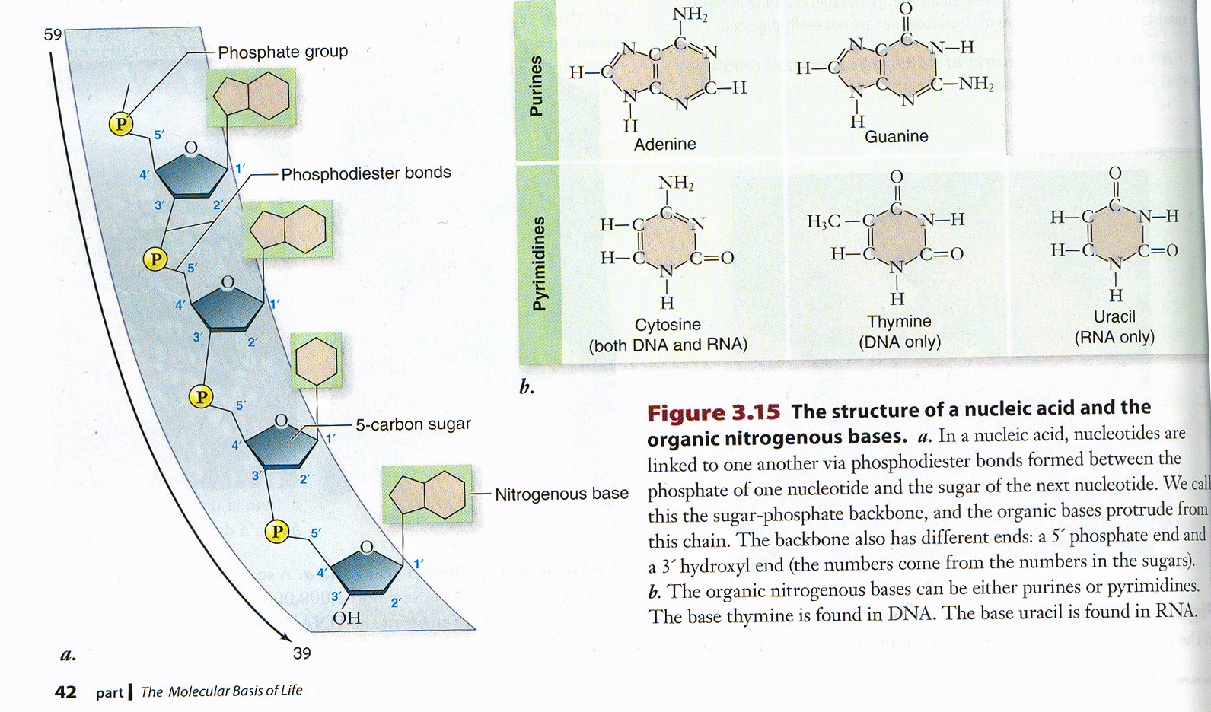
Structure of DNA

Slide 10
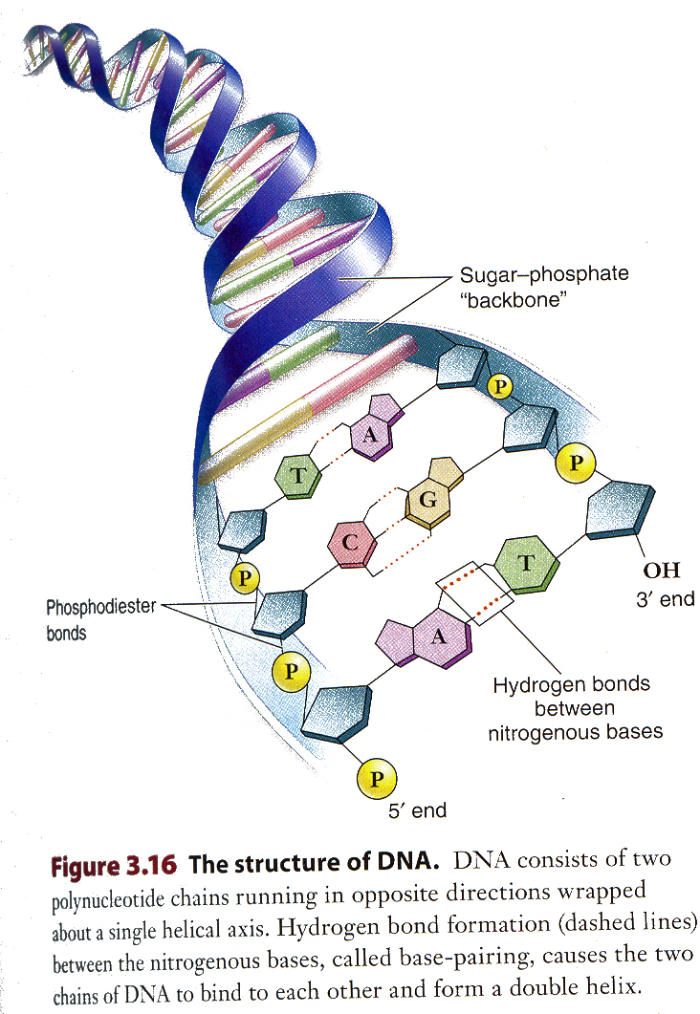
Structure of DNA

Slide 11
Plant Genomes
Plants contain three different genomes: chloroplast, mitochondrial, nuclear.
The chloroplast & mitochondrial genomes were acquired from algae or bacteria millions of years ago.
All three genomes are used in molecular genetics.

Slide 12
Nuclear, Chloroplast, Mitochondrial Genomes in Comparison
Genome | Genome Size (kbp) | Origin | Inheritance | Shape
Chloroplast | 135-160 (small) | Engulfed cyanobacteria (sometimes via an alga) | Generally maternal (Seed parent) | Circular
Mitochondrion | 200-2500 (medium) | Engulfed bacteria | Generally maternal (Seed parent) | Circular
Nuclear | Over a million (big) | Genetic history not same as species history | Biparental | Linear
More stable than mitochondrial genome
Rearrangements occur so often as to make not useful frequently
Systematists use data from all three of these genomes.

Slide 13
Chloroplast Genome (circular)
Stable within cells and species (more so than mitochondrial genome)
Large Single Copy (LSC), Small Single Copy (SSC) and Inverted Repeat (IRa & IRb regions)
Introns– noncoding regions between coding regions (exons) Gains and losses of genes and their introns are phylogenetically useful.
Rearrangements of the chloroplast genome demarcate major groups.

Slide 14
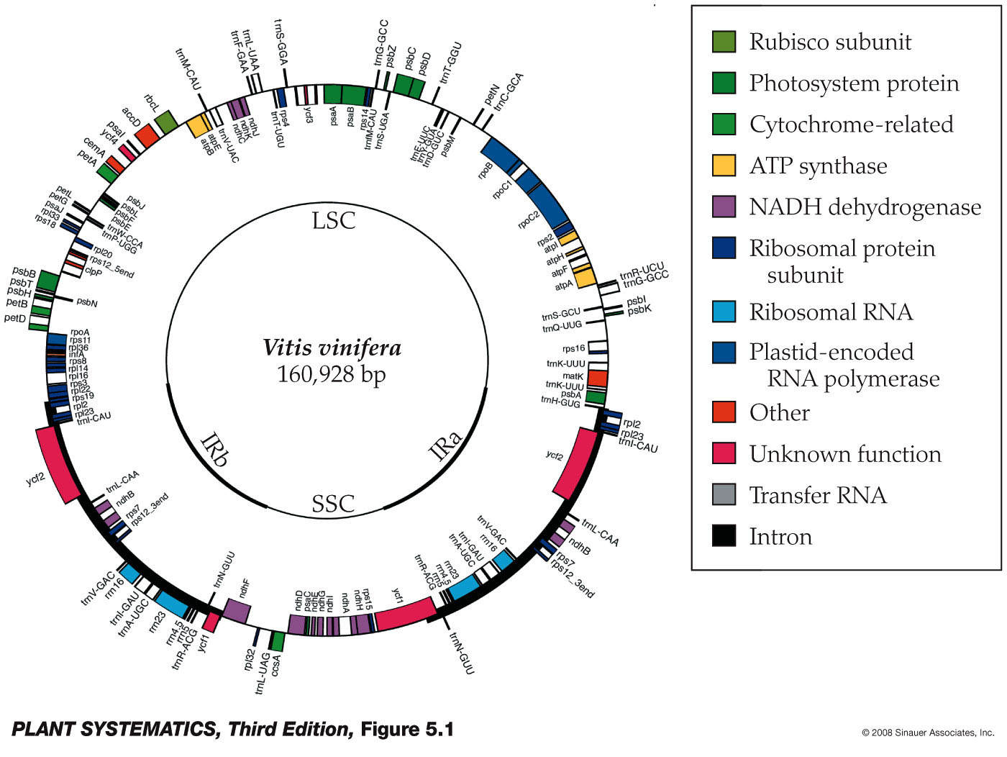
Chloroplast Genome: Vitis vinifera
rbcL, atpB
LSC= large single copy region
SSC= Small single copy region
IR= inverted repeat regions
Q: Why does this look like a circular genome?

Slide 15
Each Gene Mutates at a Different Rate
Genes coding for vital enzymes or structures tend to be more conserved.
The frequency of a mutation of a gene determines its utility for addressing a specific question
Slow rate of mutation– used for older groups
Fast rate of mutation– used to assess relationships in closely related populations

Slide 16
Gene Mutation Rate Problems
If a gene is mutating very slowly, the level of variation approaches the sequencing error rate and inferences become unreliable
If a gene is mutating very quickly, parallelisms and reversals accumulate so fast that all phylogenetic information is lost
Genes have to be picked for a given study based on what information is desired and what rate of genetic mutation will be required for that goal.

Slide 17
Methods in Molecular Systematics
Allozyme fingerprinting: different alleles produce slightly different proteins which migrate differently on an electrically charged gel. Takes about 4 hours per gel, but up to about 30 samples can be run at once. An older method, but less than $100/run.
DNA sequencing– expensive but cost coming down considerably. Much of the process has now been automated. The wave of the future is here!

Slide 18
Allozyme Fingerprinting– older method but can still be useful
Uses common enzymes to look for differences, e.g., Malate Dehydrogenase (MDH) and Phosphoglucomutase (PGM) (G1P to G6P and back reversibly)
Less automated, older method but still useful when exact sequence is not necessary– e.g., differentiating two closely related species of one genus
(Variant forms of an enzyme that are coded by different alleles at the same locus are called allozymes. These are opposed to isozymes, which are enzymes that perform the same function, but which are coded by genes located at different loci.)

Slide 19
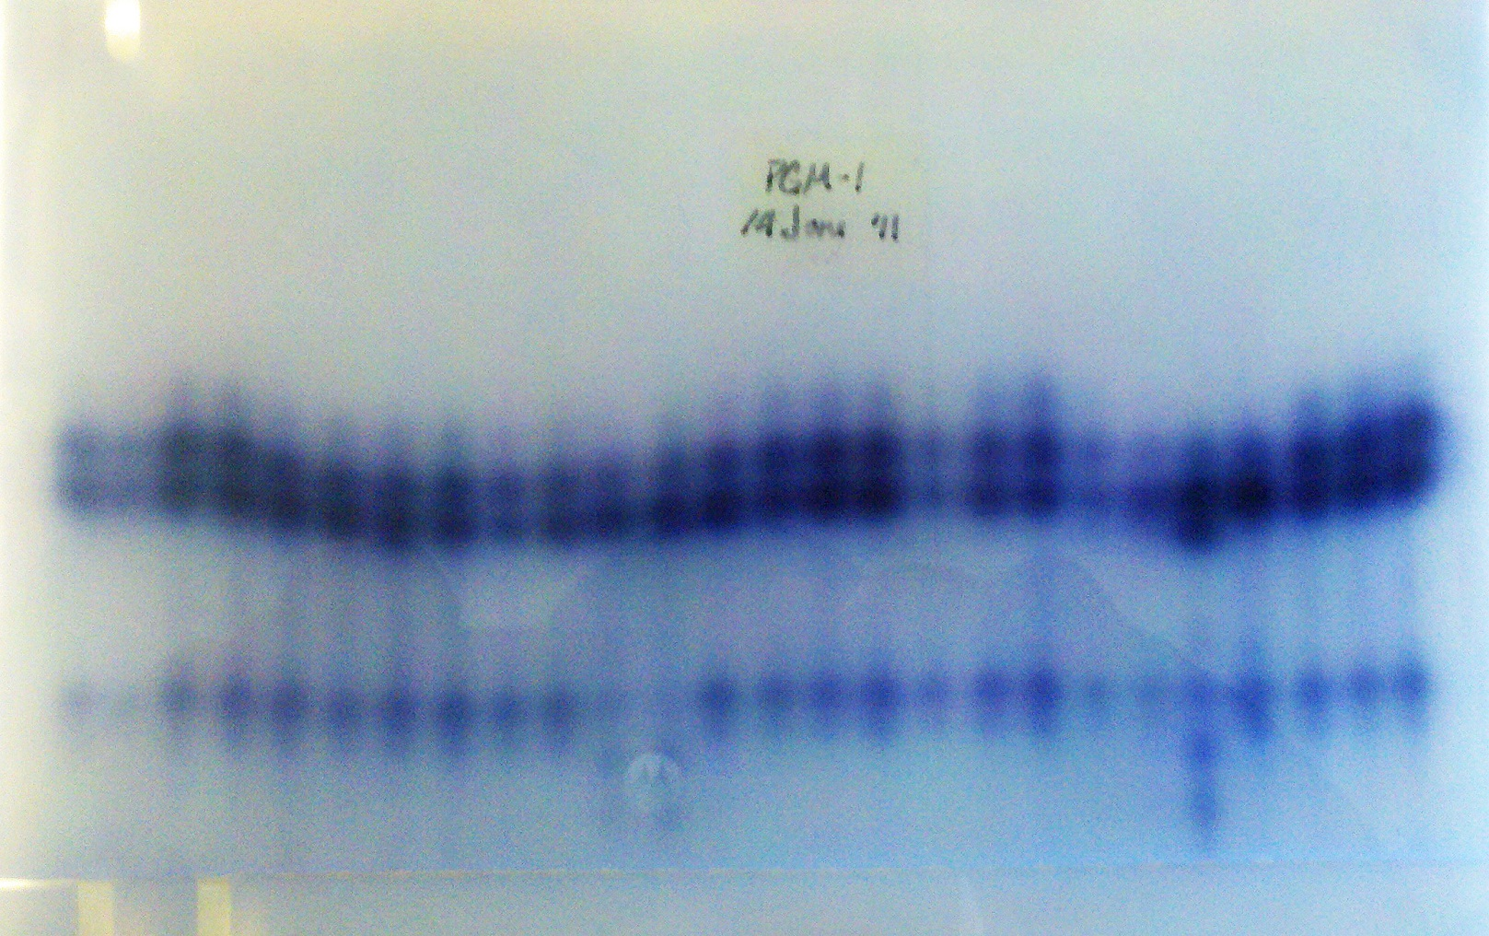
Allozyme Fingerprinting

Slide 20
DNA Sequencing– has always been limited by small amount of DNA available for sequencing
Older method: Polymerase Chain Reaction (PCR) to make huge amounts of DNA followed by Restriction Site Analysis. Best for ordering sequence of genes on a chromosome. (Nobel Prize, Kary Mullis 1993)
Newer method: use dideoxynucleotides and read colors as they come off the machine! Complete genome sequencing.

Slide 21
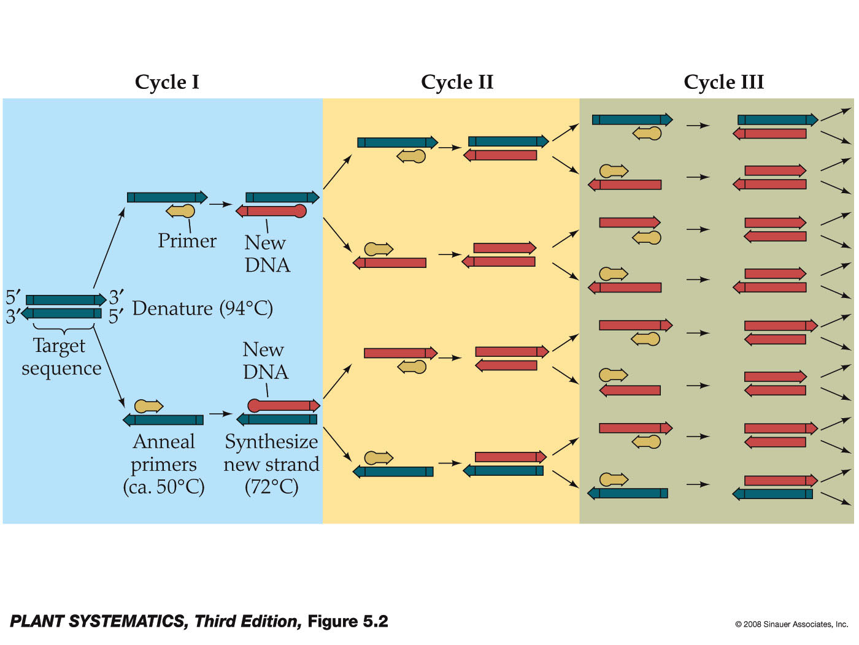
Polymerase Chain Reaction
Finding the primer is the hard part– you have to know something about the gene you want to sequence ahead of time

Slide 22
Restriction Site Analysis
(after you do PCR to get enough material)
Restriction Enzymes cut DNA at particular sequence of nucleotides.
Use one restriction enzyme, then another, then both together and you can puzzle out the order of the restriction sites by fragment size.
Useful to find order of genes on chromosome
Can cover large stretches of DNA at a time

Slide 23
Automated Gene Sequencing
We’ll go through the Sanger technique first published in 1977 because it was one of the earliest and some of the principles are still in use in more modern techniques…BUT
New automated gene sequencing techniques are being devised and patented so fast that almost as soon as you read about one a new one comes out!
Companies now advertise machines that can automate complete gene sequencing in a matter of hours, some eliminate need for PCR.

Slide 24
Automated Gene Sequencing
See: http://seqcore.brcf.med.umich.edu/doc/educ/dnapr/sequencing.html
“We can get the sequence of a fragment of DNA as long as 900 or so nucleotides. Great! But what about longer pieces? The human genome is 3 *billion* bases long, arranged on 23 pairs of chromosomes. Our sequencing machine reads just a drop in the bucket compared to what we really need! To do it, we break the entire genome up into manageable pieces and sequence them.”
Cooperative efforts are necessary to sequence large sequences.

Slide 25
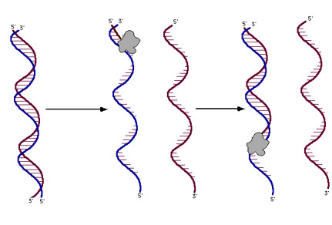
Automated Gene Sequencing
 |  | DNA sequencing reactions are just like the PCR reactions for replicating DNA (refer to the previous page DNA Denaturation, Annealing and Replication). The reaction mix includes the template DNA, free nucleotides, an enzyme (usually a variant of Taq polymerase) and a 'primer' - a small piece of single-stranded DNA about 20-30 nt long that can hybridize to one strand of the template DNA. The reaction is initiated by heating until the two strands of DNA separate, then the primer sticks to its intended location and DNA polymerase starts elongating the primer. If allowed to go to completion, a new strand of DNA would be the result. If we start with a billion identical pieces of template DNA, we'll get a billion new copies of one of its strands.

Slide 26
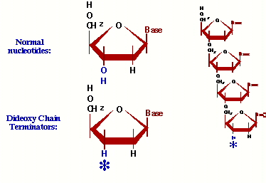

Automated Gene Sequencing
 |  | Dideoxynucleotides: We run the reactions, however, in the presence of a dideoxyribonucleotide. This is just like regular DNA, except it has no 3' hydroxyl group - once it's added to the end of a DNA strand, there's no way to continue elongating it. Now the key to this is that MOST of the nucleotides are regular ones, and just a fraction of them are dideoxy nucleotides....

Slide 27
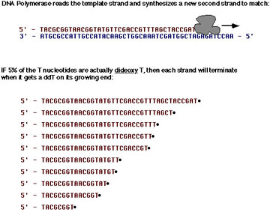
Automated Gene Sequencing
 |  | Replicating a DNA strand in the presence of dideoxy-T MOST of the time when a 'T' is required to make the new strand, the enzyme will get a good one and there's no problem. MOST of the time after adding a T, the enzyme will go ahead and add more nucleotides. However, 5% of the time, the enzyme will get a dideoxy-T, and that strand can never again be elongated. It eventually breaks away from the enzyme, a dead end product. Sooner or later ALL of the copies will get terminated by a T, but each time the enzyme makes a new strand, the place it gets stopped will be random. In millions of starts, there will be strands stopping at every possible T along the way. ALL of the strands we make started at one exact position. ALL of them end with a T. There are billions of them ... many millions at each possible T position. To find out where all the T's are in our newly synthesized strand, all we have to do is find out the sizes of all the terminated products!

Slide 28
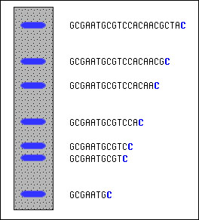
Automated Gene Sequencing
 |  | Here's how we find out those fragment sizes. Gel electrophoresis can be used to separate the fragments by size and measure them. In the cartoon at left, we depict the results of a sequencing reaction run in the presence of dideoxy-Cytidine (ddC). First, let's add one fact: the dideoxy nucleotides in my lab have been chemically modified to fluoresce under UV light. The dideoxy-C, for example, glows blue. Now put the reaction products onto an 'electrophoresis gel' (you may need to refer to 'Gel Electrophoresis' in the Molecular Biology Glossary), and you'll see something like depicted at left. Smallest fragments are at the bottom, largest at the top. The positions and spacing shows the relative sizes. At the bottom is the smallest fragment that's been terminated by ddC; that's probably the C closest to the end of the primer (which is omitted from the sequence shown). Simply by scanning up the gel, we can see that we skip two, and then there's two more C's in a row. Skip another, and there's yet another C. And so on, all the way up. We can see where all the C's are.

Slide 29
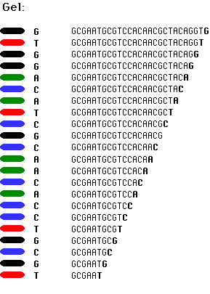
Automated Gene Sequencing
 | Putting all four deoxynucleotides into the picture: Well, OK, it's not so easy as reading just C's, as you perhaps saw in the last figure. The spacing between the bands isn't all that easy to figure out. Imagine, though, that we ran the reaction with *all four* of the dideoxy nucleotides (A, G, C and T) present, and with *different* fluorescent colors on each. NOW look at the gel we'd get (at left). The sequence of the DNA is rather obvious if you know the color codes ... just read the colors from bottom to top: TGCGTCCA-(etc). (Forgive me for using black - it shows up better than yellow)

Slide 30
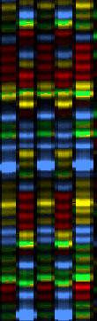
Automated Gene Sequencing
 |  | An Automated sequencing gel: That's exactly what we do to sequence DNA, then - we run DNA replication reactions in a test tube, but in the presence of trace amounts of all four of the dideoxy terminator nucleotides. Electrophoresis is used to separate the resulting fragments by size and we can 'read' the sequence from it, as the colors march past in order. In a large-scale sequencing lab, we use a machine to run the electrophoresis step and to monitor the different colors as they come out. Since about 2001, these machines - not surprisingly called automated DNA sequencers - have used 'capillary electrophoresis', where the fragments are piped through a tiny glass-fiber capillary during the electrophoresis step, and they come out the far end in size-order. There's an ultraviolet laser built into the machine that shoots through the liquid emerging from the end of the capillaries, checking for pulses of fluorescent colors to emerge. There might be as many as 96 samples moving through as many capillaries ('lanes') in the most common type of sequencer. At left is a screen shot of a real fragment of sequencing gel (this one from an older model of sequencer, but the concepts are identical). The four colors red, green, blue and yellow each represent one of the four nucleotides. The actual gel image, if you could get a monitor large enough to see it all at this magnification, would be perhaps 3 or 4 meters long and 30 or 40 cm wide.

Slide 31
Most Studied Gene Sequences
Rubisco (from chloroplast, rbcL)
Ribosome subunits (from nucleus, 18S & 26S)
ATP synthase (from chloroplast, atpB)

Slide 32
The Future is Now
“Next Gen” sequencing (Sanger=1st gen, Next Gen= 2nd gen) though techniques much faster, still is basically sequencing by synthesis after breaking DNA strand in to shorter segments. A critical limitation.
There are now 3rd gen sequencing techniques under development: direct sequencing of single DNA molecules allowing longer read lengths. Currently these techniques have a higher error rate than 2nd gen.

